Slide 1


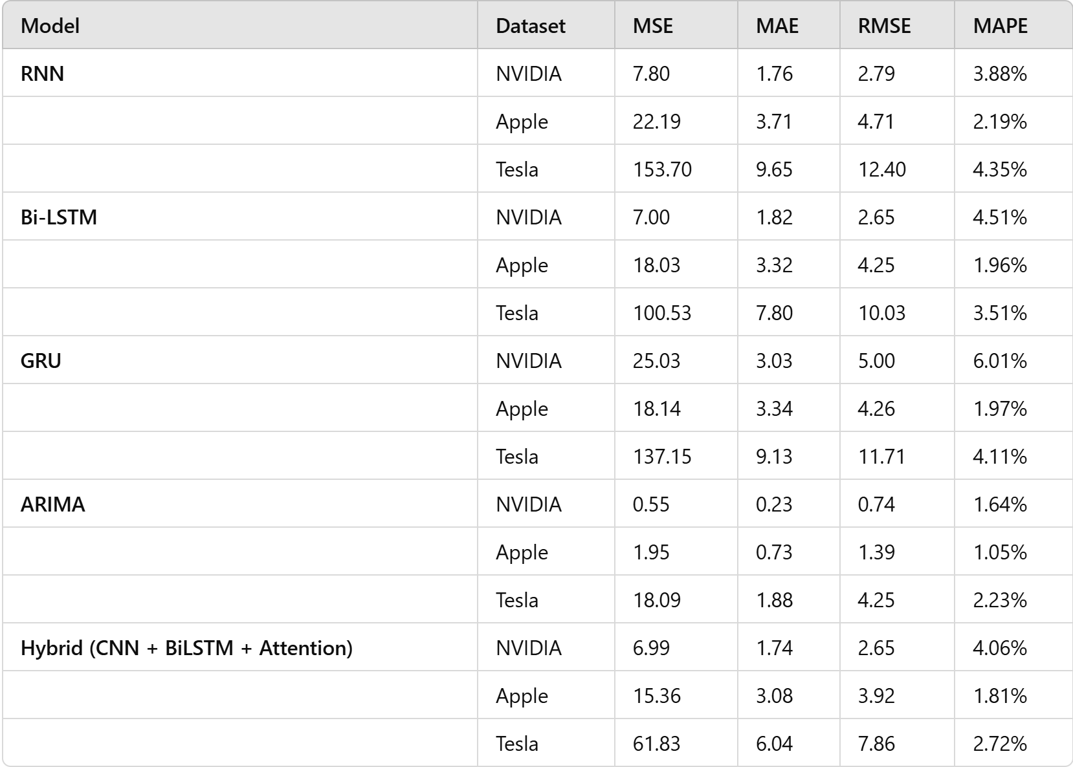
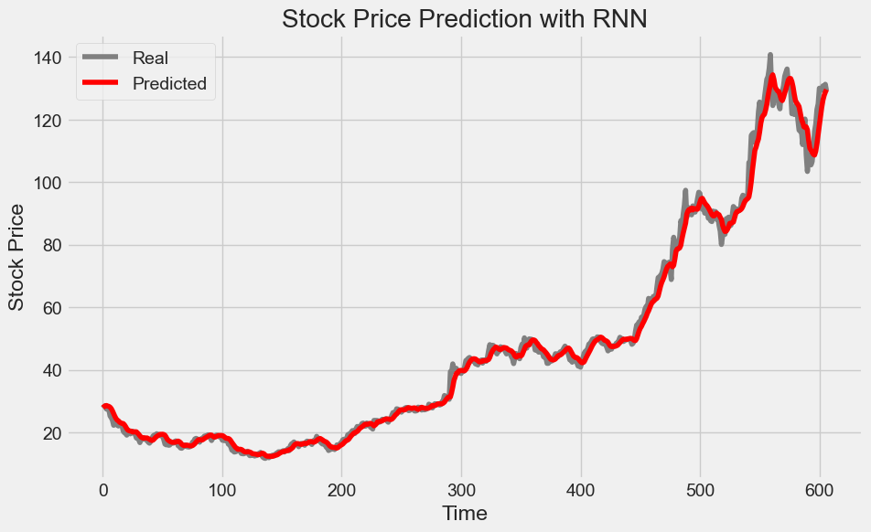
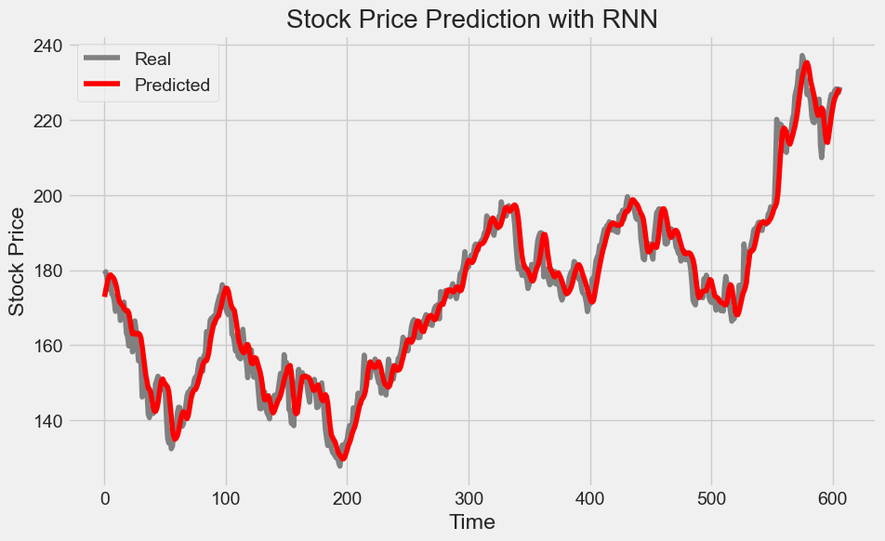
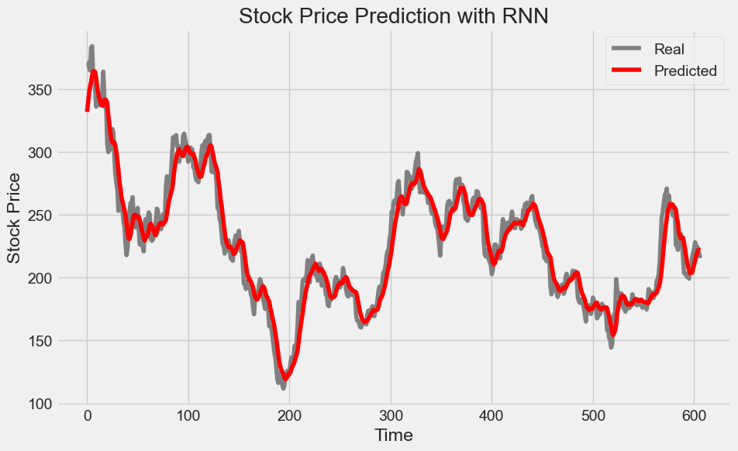
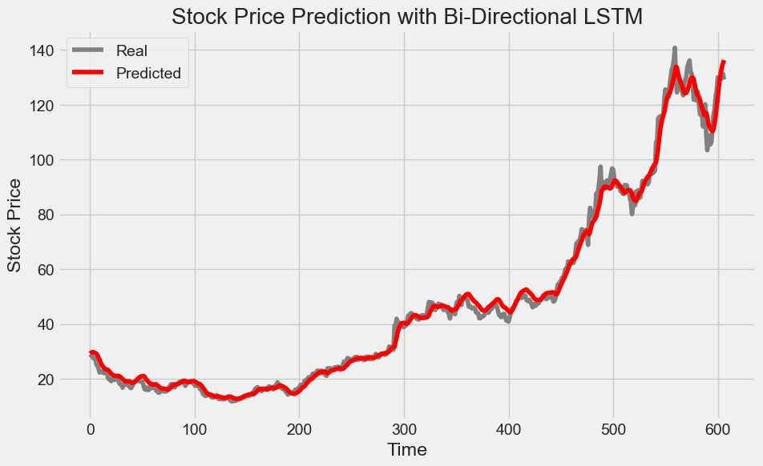
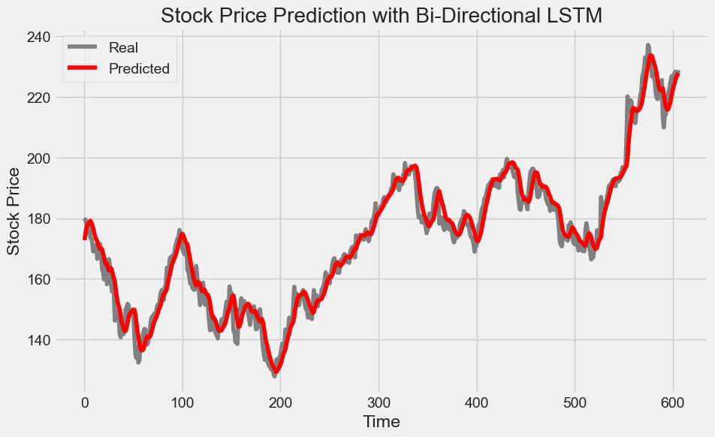
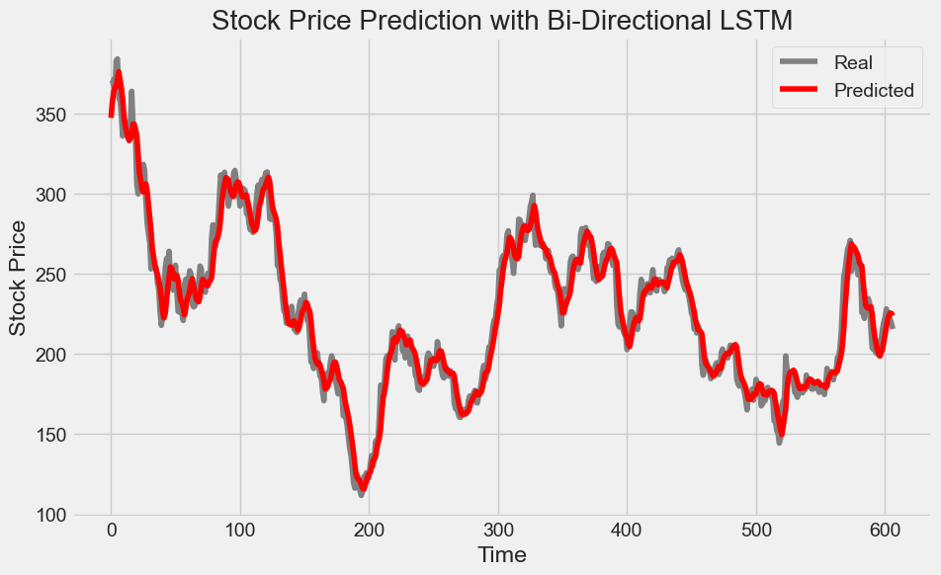
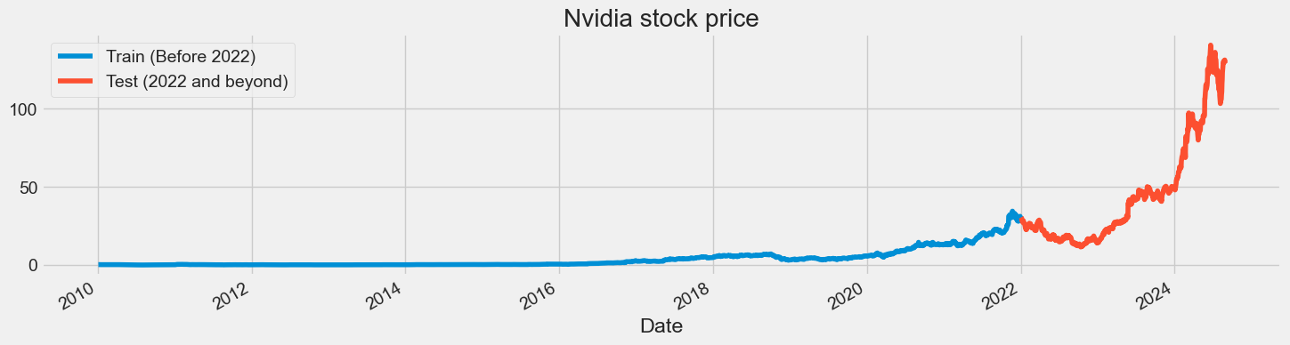
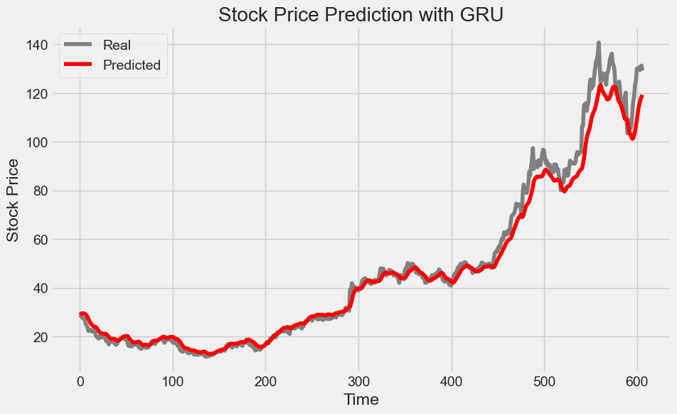


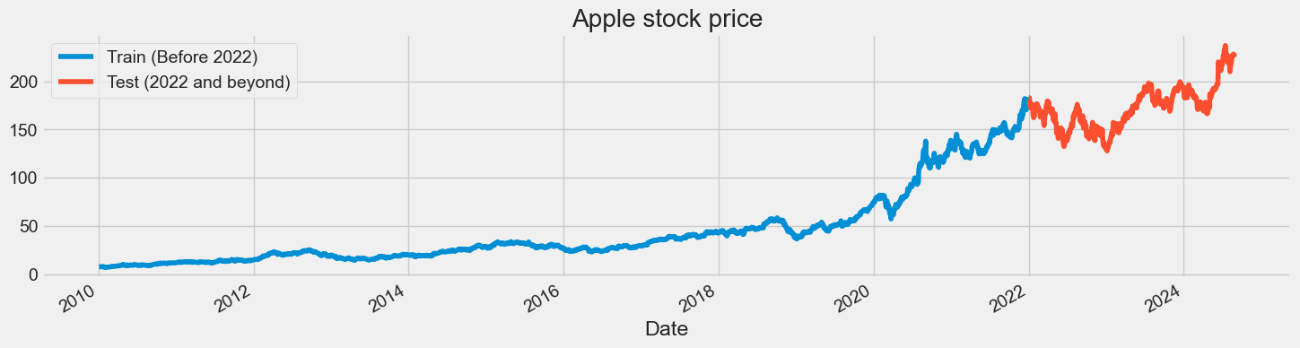
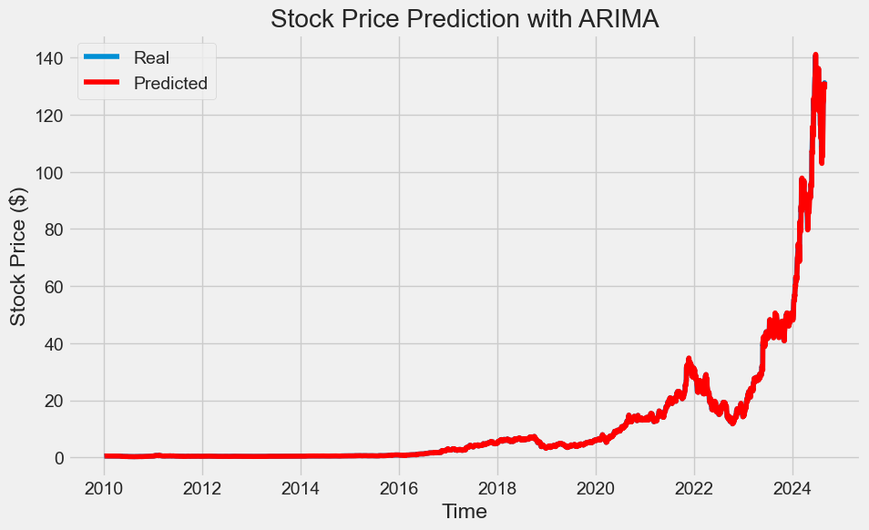
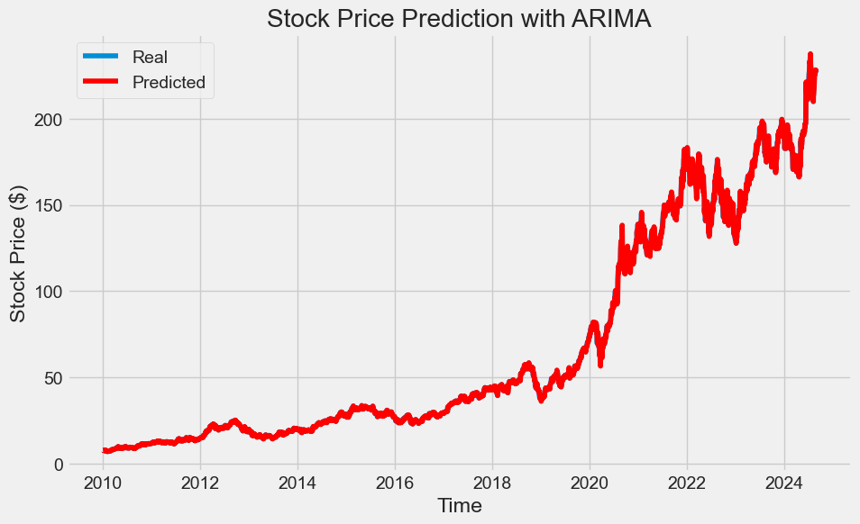
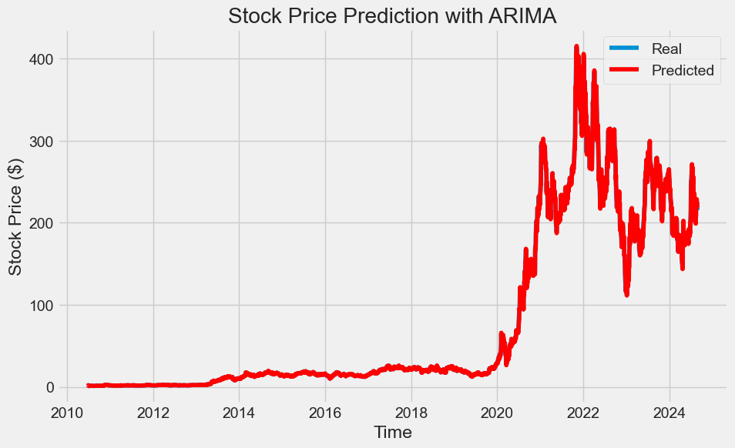
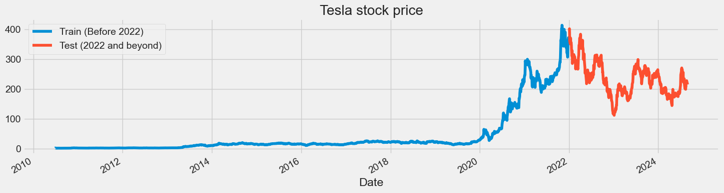
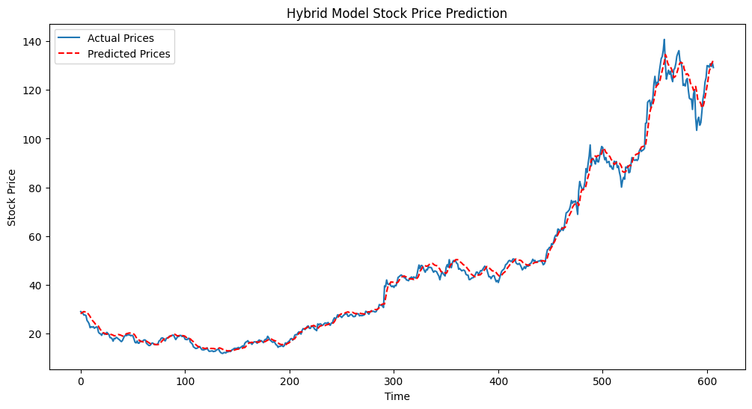
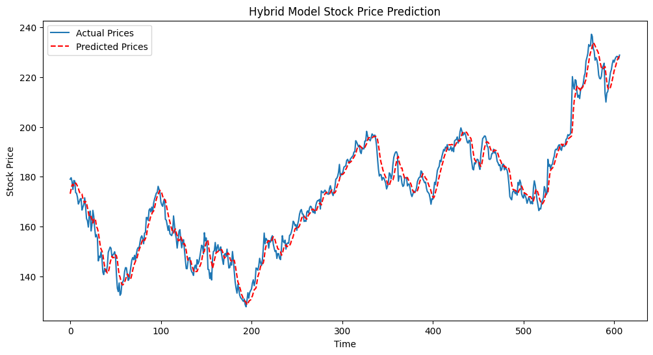
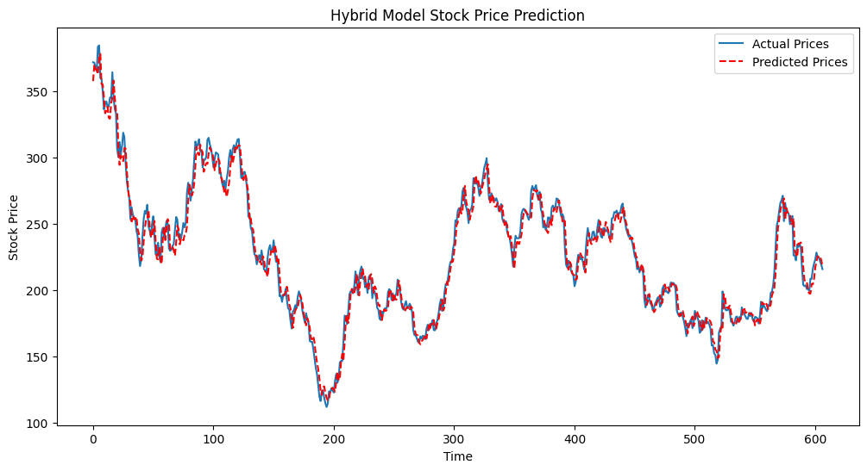
Analysis of Base Model vs Hybrid Model Architecture for Time Series Forecasting
Student: Shane Stoll | Advisor: Uzma Mushtaque
Problem
Approach
Model Results
Model Predictions
Accurately forecasting stock prices remains a major challenge in the financial domain due to the volatile, nonlinear, and dynamic nature of markets. Traditional statistical models like ARIMA have been widely used for time series forecasting, but they often struggle to capture the more complex temporal dependencies and patterns present in modern financial data. In contrast, recent advancements in deep learning—particularly Recurrent Neural Networks (RNNs), Long Short-Term Memory (LSTM) models, and Gated Recurrent Units (GRUs)—offer promising alternatives. Motivated by prior research on hybrid architectures, specifically the CNN-BiLSTM-Attention model proposed in the paper "Predicting Financial Enterprise Stocks and Economic Trends Based on Hybrid Neural Network Models", this project evaluates the performance of classical models alongside deep learning and hybrid approaches. We aim to determine which model architecture most effectively predicts stock price movements across three distinct datasets: NVIDIA, Apple, and Tesla.
Data Acquisition & Preprocessing:
Stock data for NVIDIA, Apple, and Tesla collected using the yfinance API and processed into CSV files.
Only the 'High' price column was used for consistency.
Data was scaled using MinMaxScaler for compatibility with neural network models.
The dataset was split such that data from 2010 to 2021 was used for training and subsequent years for testing, and the rest of the dataset was used for testing.
Input sequences were generated using a sliding window of 60 time steps (n_steps = 60)
Differencing and stationarity tests (ADF) were conducted for ARIMA/SARIMA models.
Model Construction and Training:
RNN: A simple recurrent network trained to understand time dependencies.
LSTM & Bi-Directional LSTM: Built using stacked layers with and without dropout/early stopping.
GRU: Tested with and without dropout for comparison.
ARIMA/SARIMA: Traditional models were fitted after checking for stationarity, with log transformation to reduce variance.
Hybrid Model (CNN-BiLSTM-Attention): Inspired by research literature, combining convolutional, recurrent, and attention layers for sequence learning.
Evaluation:
All models were evaluated using:
Mean Squared Error (MSE)
Mean Absolute Error (MAE)
Root Mean Squared Error (RMSE)
Mean Absolute Percentage Error (MAPE)
Graphical predictions were plotted against real stock values to visually assess prediction accuracy.
Cross-Dataset Validation:
To avoid sampling bias and ensure model robustness, the best-performing models were tested on Apple and Tesla.
Nvidia
Apple
Tesla
Base Model Architecture
Hybrid Model Architecture
Conclusion
The Recurrent Neural Network (RNN) consisted of a two-layer vanilla RNN with tanh activations and a single Dense output unit. It used the RMSprop optimizer with a learning rate of 0.0005, a batch size of 32, and was trained over 200 epochs. Dropout was initially considered but later removed after experiments showed that the RNN performed best without regularization.
The Bi-Directional LSTM (Bi-LSTM) model featured one or two Bidirectional (LSTM) layers (depending on whether return_sequences was enabled), followed by a Dense output layer. It used 300 hidden units and a dropout rate of 0.3 in early trials. However, the final and best-performing Bi-LSTM model omitted dropout entirely. RMSprop again served as the optimizer with a learning rate of 0.0005, and early stopping was applied with a patience of 10 to prevent overfitting.
The GRU (Gated Recurrent Unit) model also used a single hidden layer with 300 units and a Dense output layer. Like the Bi-LSTM, dropout was tested but later removed entirely, as its absence yielded better results. The GRU used RMSprop with a 0.0005 learning rate and followed the same training procedure as the other deep learning models. While it performed well on the NVIDIA dataset, its performance was less competitive on the Apple and Tesla data.
The Autoregressive Integrated Moving Average (ARIMA) model was constructed using the statsmodels library. Stationarity was confirmed using the Augmented Dickey-Fuller test, and differencing was applied where necessary. Log transformation of the stock prices significantly improved performance, especially on the NVIDIA dataset. Model parameters (p, d, q) were chosen based on autocorrelation and partial autocorrelation plots, with (1, 1, 1) producing the best results. Evaluation metrics were calculated using the transformed and inverse-transformed series.
The hybrid model was designed by integrating three powerful deep learning components:
Convolutional Neural Networks (CNN)
Bidirectional Long Short-Term Memory (Bi-LSTM) layers
Attention mechanism.
The architecture begins with a 1D convolutional layer that extracts localized temporal patterns and features from the stock price sequences. This was followed by Bi-LSTM layers, chosen for their ability to learn long-term dependencies in both forward and backward temporal directions, capturing richer context than standard LSTM or RNN models. Finally, a self-attention mechanism was added to allow the model to selectively focus on the most relevant time steps, improving interpretability and performance, especially in sequences with volatile behavior. Hyperparameters such as a step size of 60, 300 LSTM units, a learning rate of 0.0005, and the RMSprop optimizer were chosen based on prior performance in Bi-LSTM experiments. Dropout was intentionally omitted after experimentation revealed it hindered the model’s ability to learn complex patterns in financial time series data. This architecture was inspired by prior research and tailored through iterative experimentation for robustness and generalizability across different stock datasets.
This project implemented and evaluated five model architectures for stock price forecasting: RNN, Bi-Directional LSTM, GRU, ARIMA, and a hybrid CNN-BiLSTM-Attention model inspired by prior research. Across all three datasets—NVIDIA, Apple, and Tesla—the statistical ARIMA model achieved the lowest error values overall, underscoring its strength in univariate forecasting, but was unable to capture intricate details in the prediction of stock price value. Among deep learning approaches, the stock trends were better captured, with the hybrid model consistently outperformed the standalone RNN, Bi-LSTM, and GRU models across every dataset. These results support the findings in the original research paper and demonstrate that combining convolutional layers (for spatial feature extraction), Bi-LSTM layers (for temporal learning), and attention mechanisms (for dynamic weighting) can significantly enhance predictive performance. While more computationally intensive, the hybrid model proved to be the most accurate deep learning solution, validating its effectiveness for complex financial time series forecasting. For applications that require minimum MSE, MAE, etc, but don’t need to model exact trend details, ARIMA is a suitable model. For more complex applications, the hybrid model is better equipped to handle complex trend details.
1D Convolutional Layer
MaxPooling Layer
Bi-Directional LSTM Layer
Attention Layer
References
Input Layer
Dense Output Layer
Zheng, H., Wu, J., Song, R., Guo, L., & Xu, Z. (2024, July 11). Predicting Financial Enterprise Stocks and Economic Data Trends Using Machine Learning Time Series Analysis. Preprints.org. https://doi.org/10.20944/preprints202407.0895.v1

